Slide 1
Criminal Law 2.5 Investigation & Pre-Trial Proceedings

Slide 2
Warm-Up: Monday, March 30
Based on your understanding from television and/or movies, what does it actually take to bring a crime to trial?

Slide 3
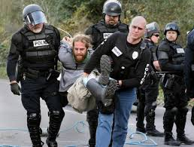
Arrest
Takes place when someone suspected of a crime is taken into custody
A person can be taken into custody one of two ways:
Arrest warrant
Probable cause

Slide 4
Arrest Warrant
An arrest warrant is a court order commanding the named person be taken into custody.
Officers can obtain a warrant from a judge or magistrate
Arrest warrants can be filed by a police officer, victim, or witness

Slide 5
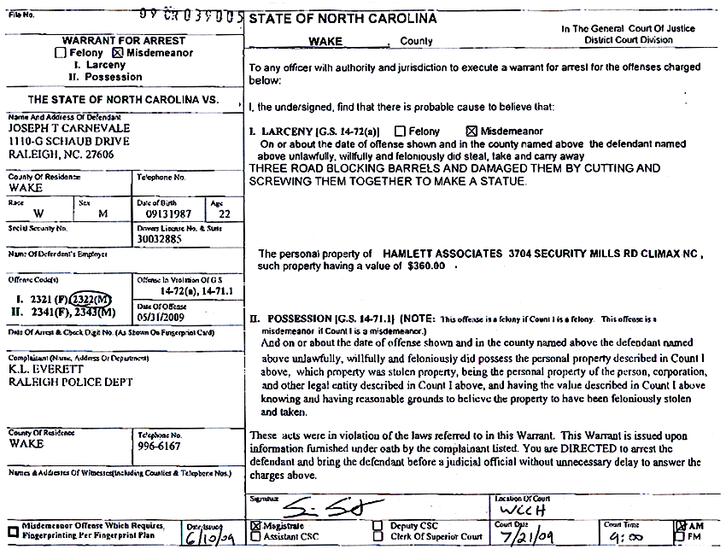

Slide 6
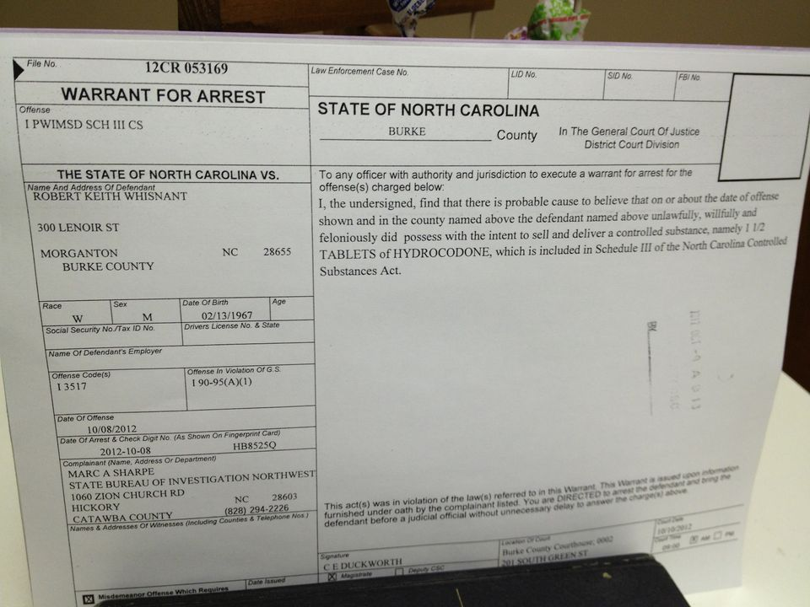

Slide 7
Probable Cause
Requires more than mere suspicion. Some facts must be present that indicate that the person arrested has committed a crime.
Drug Courier Profile
Used to provide a basis to stop and question a person to help establish probable cause
Based on age, race, appearance, behavior, and mannerisms.

Slide 8
Reasonable Suspicion
Police can stop and question someone when they believe the individual is involved in criminal activity.
A person may decline to say anything to the officer and/or leave.
A police officer is not legally permitted to take the silence into account in determining probable cause.

Slide 9
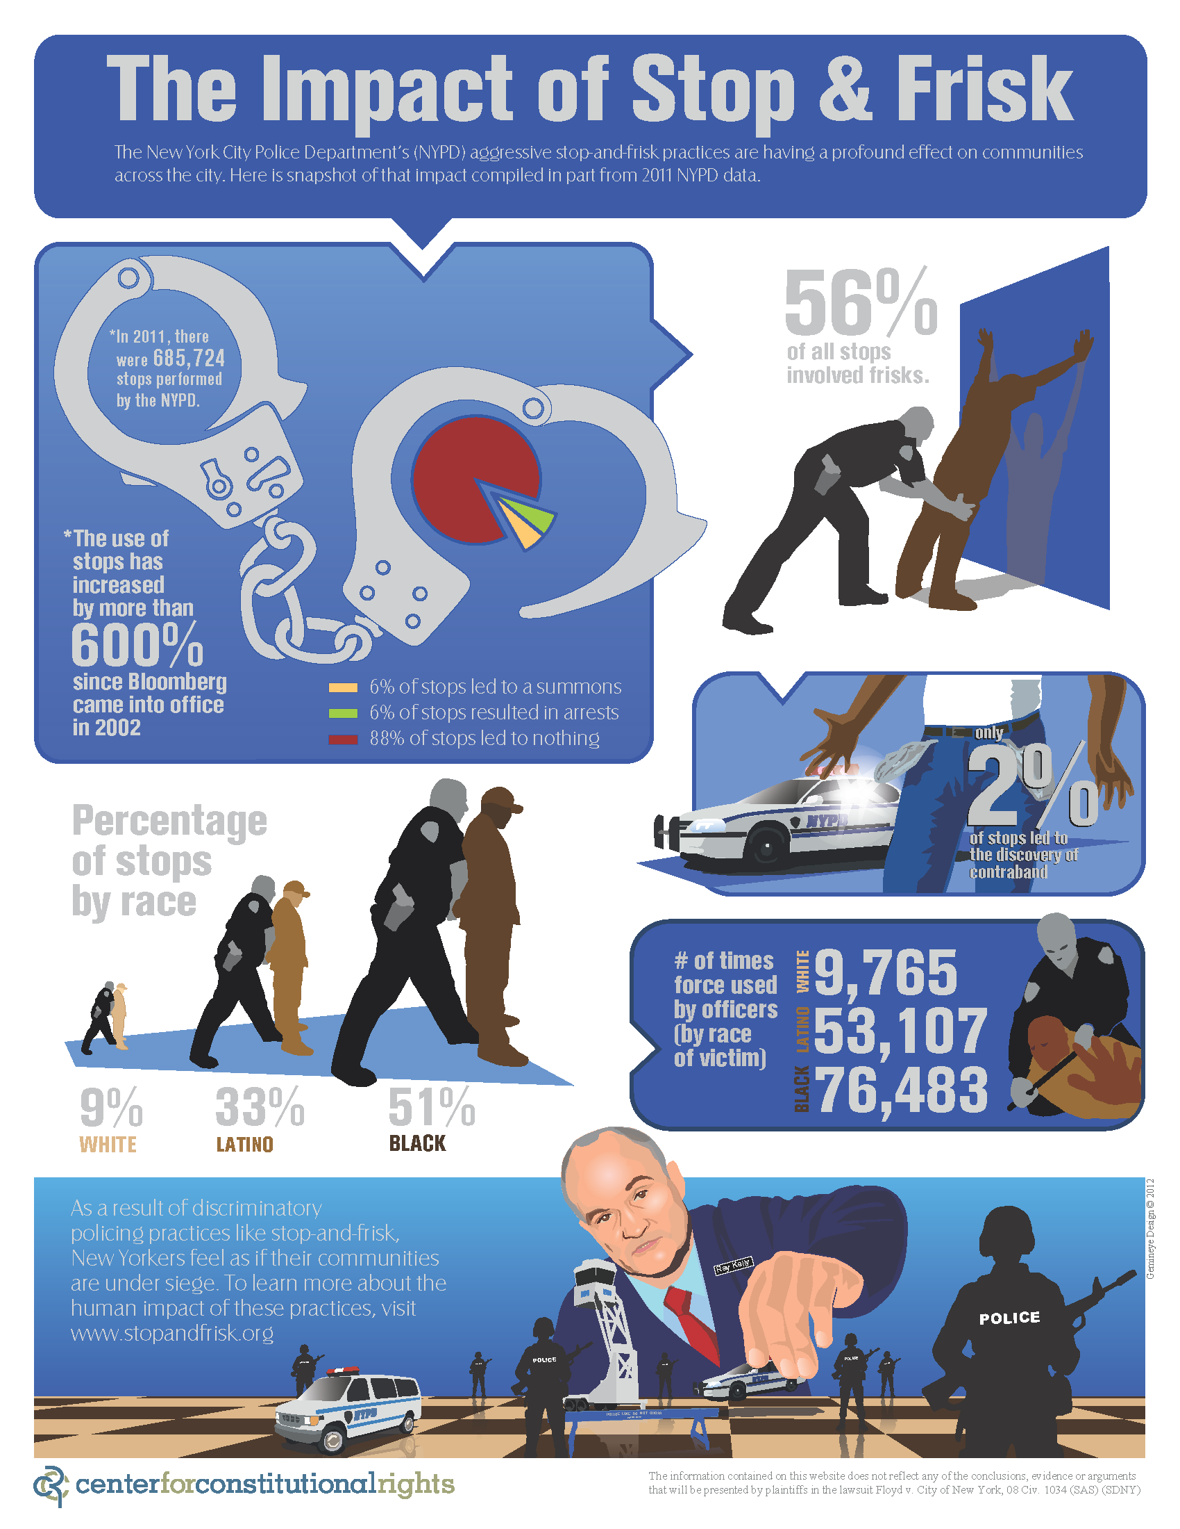
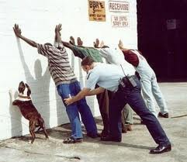
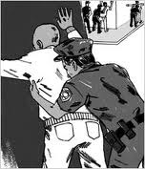

Slide 10
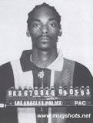
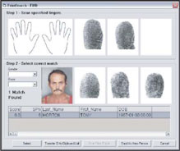
Booking
A booking is the formal process of making a police record of an arrest
The accused is asked for basic information and is typically fingerprinted and photographed.

Slide 11
Initial Appearance
At the initial appearance, the judge explains the defendant’s rights and advises him or her of the exact nature of the charges.
An attorney is appointed if necessary, and the judge may set bail.
The entire amount may be required, or the defendant may only be asked to pay a small portion.
Personal recognizance is an alternative to cash bail, where a person must promise to return and must be considered likely to return for trial.
If the crime committed is a misdemeanor, at this point the defendant can plead guilty or not guilty.

Slide 12
Preliminary Hearing
A preliminary hearing is a screening device used in felony cases to determine if there is enough evidence to require the defendant to stand trial.
The prosecutor must establish a crime has probably been committed and that the defendant probably did it.
If the judge finds no probable cause, the case may be dismissed. The prosecution can choose to submit the case to a grand jury following a dismissal.

Slide 13
Indictment
An indictment is a formal charge with criminal action.
Indictments occur only after a grand jury has determined if there is sufficient cause to believe that a person committed a crime.

Slide 14
Felony Arraignment
At an arraignment, the defendant must appear before court and enter a plea.
If a defendant pleads guilty, the judge sets a date for sentencing.
If a defendant pleads not guilty, the judge sets a date for trial.

