Slide 1
Civil Law 3.5 Defenses to Torts
Law & Justice

Slide 2
Defenses to Negligence
Contributory negligence: as a plaintiff, you can not receive damages from the defendant if your own negligence contributed in any way to the harm you suffered.
Comparative negligence: dividing the loss to the degree to which each person is at fault.
You may receive some but not all of the money you seek, because you may be somewhat at fault.
Assumption of the risk: a person voluntarily encounters a known danger and decides to accept that risk of danger.

Slide 3
Defenses to Intentional Torts
Consent: the plaintiff agreed to the harmful conduct and thus gave up the right to sue later.
Can be written, spoken, or assumed based on the situation
Privilege: justifies behavior that would otherwise be a tort, because the defendant’s interests or the public’s interests require it.
Examples of privilege: legal authority, self-defense, defense of property

Slide 4
Defenses to Strict Liability
A defendant could show there was no causation or there are no damages.
(Product Liability) If a consumer misuses a product or ignores clear safety warnings, manufacturers or sellers may have a defense.
Many courts argue manufacturers must anticipate some misuses and make products safe against any foreseeable misuse.

Slide 5
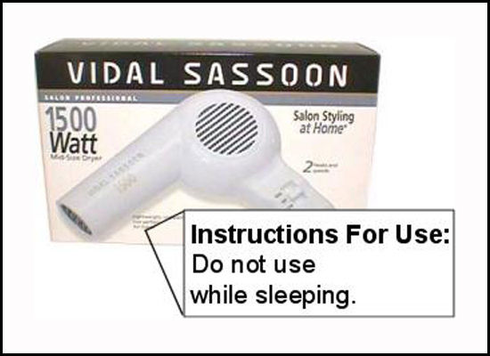
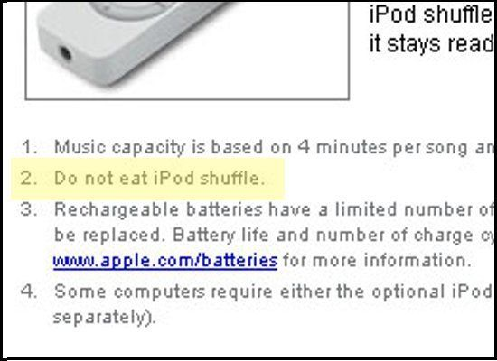
Product Liability: Warning Labels

